Slide 1

Online Banking
Cyber Security Application
Amitha Murali

Slide 2

Problem statement
Online Banking applications of today face threats of all sorts over the internet. Making the application secure and keeping it secure from cyber attacks is huge challenge for banks

Slide 3
Problem statement
In today’s world with all our vital information exposed over the internet, security is of highest priority. Banking applications are at most risk as the information they hold can give hackers direct access to all the customers funds and accounts. Guarding the customer data is very
crucial.

Slide 4

Approach
Build a java based banking application to simulate the cyber security threats and also demonstrate the features that would help make the application secure.

Slide 5




Personas
Customer
Branch Manager
Employee
Admin
Security office
Check account balance
Transfer funds from one account to another
View bank statements (transaction)
Add/delete beneficiary
Raise security concerns
Manage Bank employees of his/her branch
Manage customer accounts (CRUD operations)
Approve new beneficiary
Manage customer accounts (CRUD operations)
Approve new beneficiary
Manage Bank branches
Manage Branch Managers (CRUD operations)
Analyze security concerns raised by customer and take the required action.
Monitor the overall health of the application.

Slide 6
Key Features
-Multi factor authentication with OTP generated each time and emailed to user for authentication.
- Malicious request identification and treatment by monitoring IP addresses
-Encryption of passwords
- Security questions for additional layer of security.
- Accept passwords with certain strength
- Captcha implementation to ensure human login to the system

Slide 7
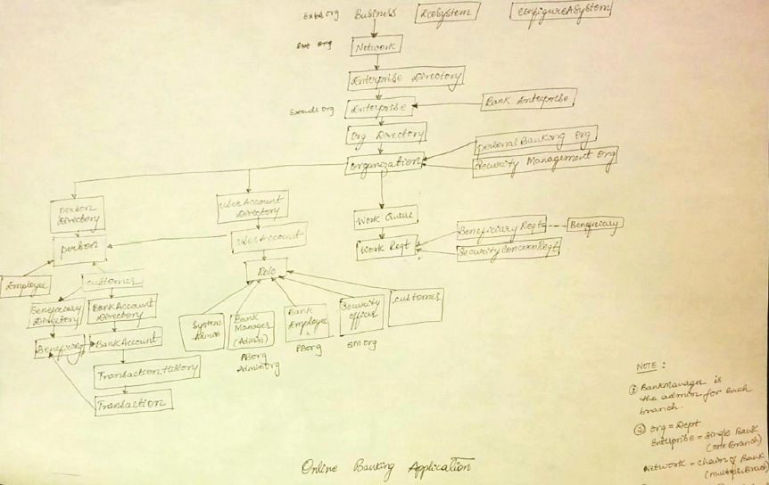
Object Model

Slide 8
Screenshots

Slide 9
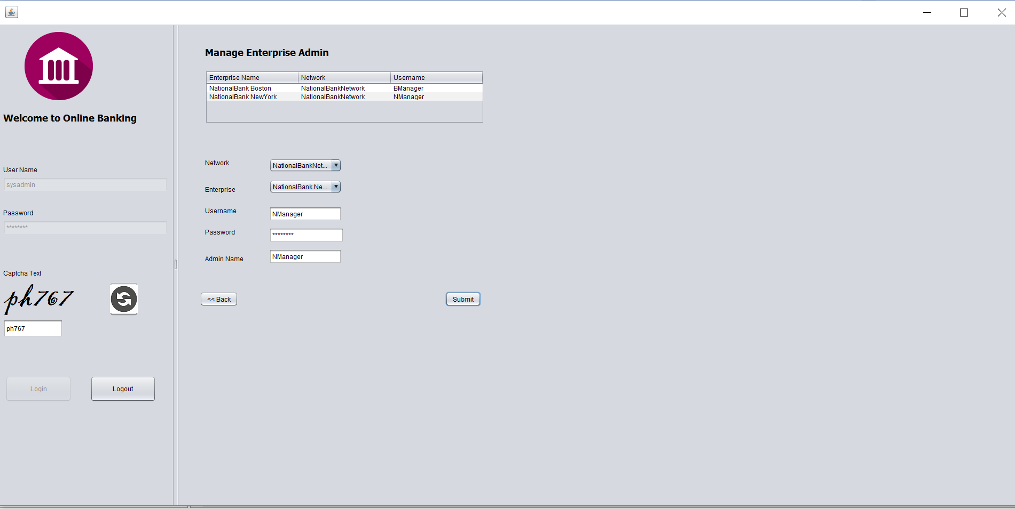
Sys admin screen

Slide 10
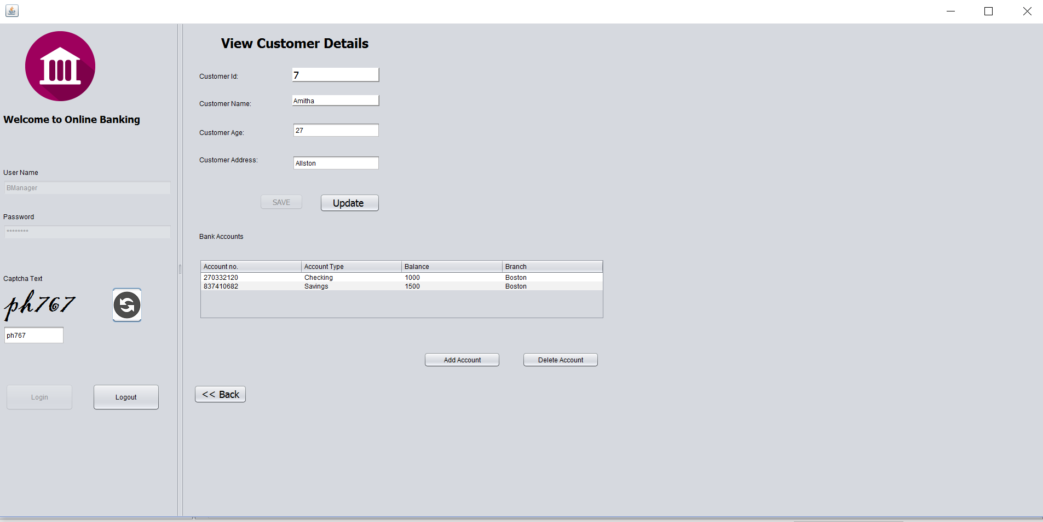
Manager screen

Slide 11
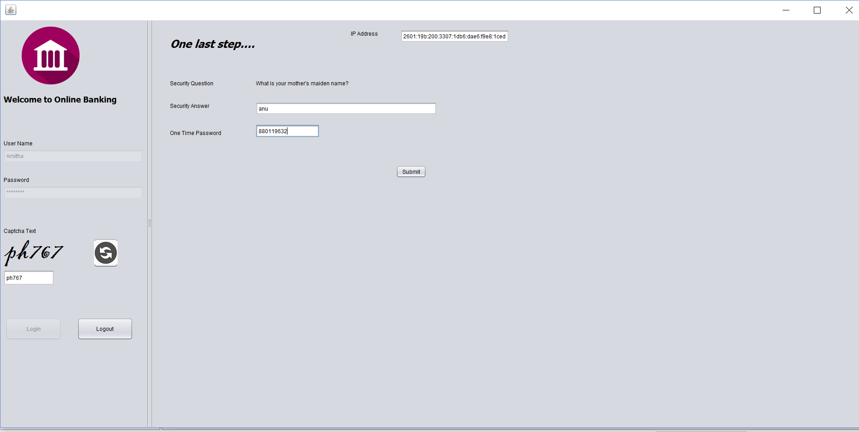
Customer authentication

Slide 12
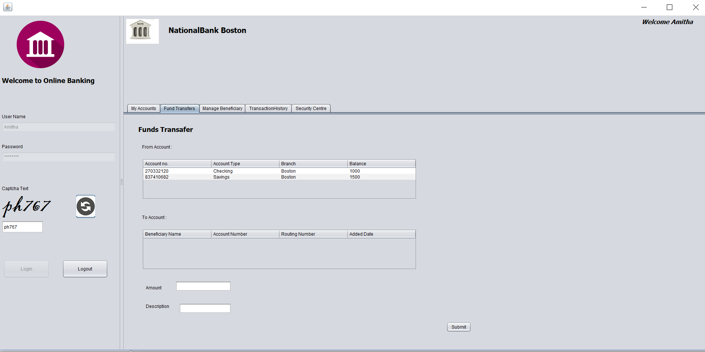
Customer Dashboard

Slide 13
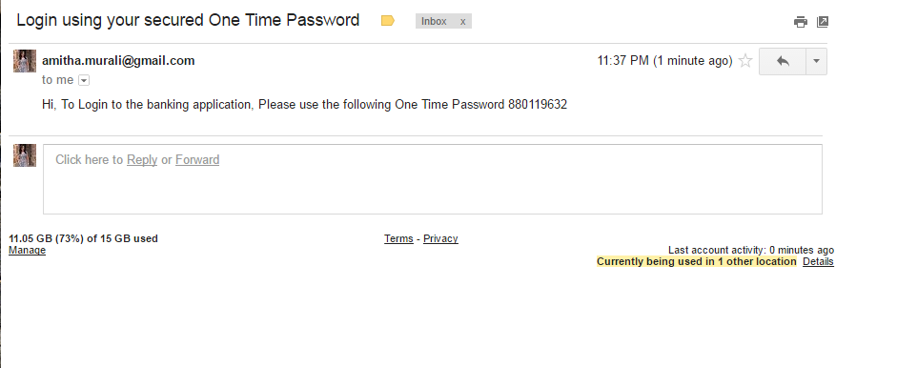
OTP E-mail

